Slide 1
Hospital Appointment Booking system UI, A/B Test Report For Non-Technical Stakeholders
Prepared by Zahoor Ishfaq
Portfolio Project

Slide 2
Business Problem
Our hospital has seen a decline in patient booking conversion rates over the past year (down 8% YoY), resulting in an estimated $2.3M annual loss in missed appointments. The current booking interface is outdated, leading to patient frustration and complaints.

Slide 3
Experiment Setup
Duration: Jan – Jun 2024
Control (A): Current booking UI-UX
Treatment (B): New streamlined UI-UX with simplified form and progress indicators
Sample Size: ~29,500 sessions (A: 14,184 | B: 15,272)
Avg. Booking Value: $340
Investment: $200K rollout

Slide 4
Hypotheses
Null (H0): Conversion rate (B) ≤ Conversion rate (A)
Alternative (H1): Conversion rate (B) > Conversion rate (A)

Slide 5
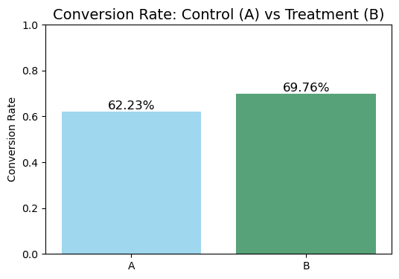
Primary Results
Conversion rate: 62.2% → 69.8%
Absolute lift: 7.5%
Relative lift: 12.1%
Statistically significant (p < 0.001)

Slide 6
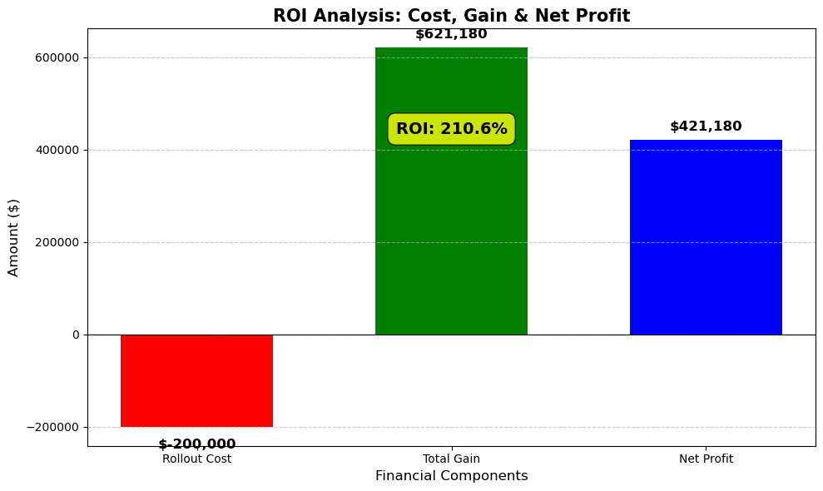
Business Impact
Net revenue uplift: $190,631
ROI on rollout cost ($200K): 210%
Payback period for Rollout cost: 2.9 months
Confidence: 95% positive ROI

Slide 7
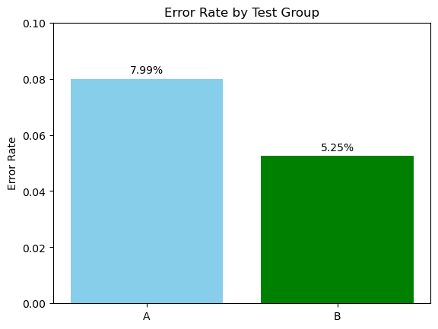
Secondary Metrics
Error rate: Decreased from 7.99% → 5.25%

Slide 8
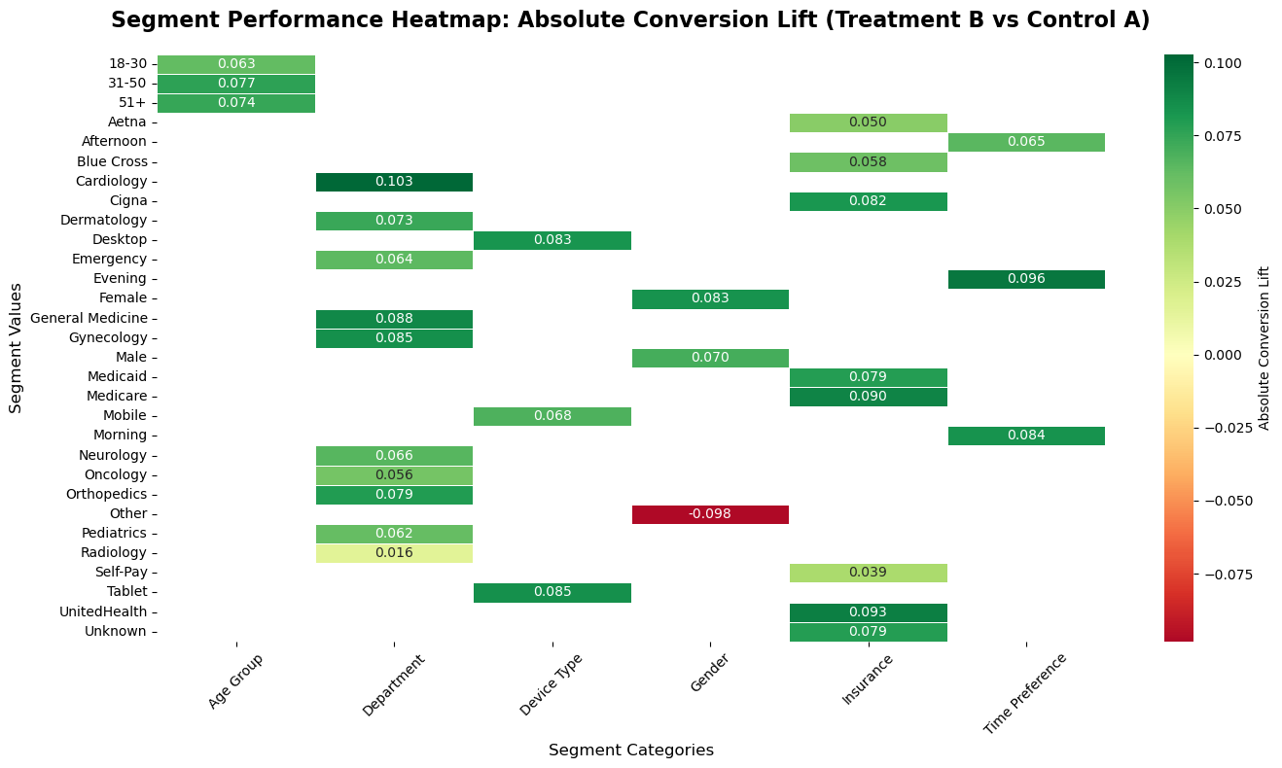
Segment Analysis
All major devices, departments, and age groups showed positive lift
Emergency department & peak booking hours benefited most
Note: Gender = 'Other' showed negative lift (−13.7%)

Slide 9
Risks & Mitigation
Risk: Segment-Specific Underperformance Some subgroups (e.g., “Other” gender) showed weaker or negative lift. Mitigation: Targeted follow-up tests & segment-specific UI adjustments.
Risk: Mobile Experience Variability Mobile shows less performance than desktop and tablet could drive complaints. Mitigation: Ongoing monitoring via dashboards, fast-track UX improvements for mobile.
Risk: Data Quality / Tracking Issues Test data had missing values and possible bot traffic Mitigation: Strengthen tracking system to stop bot traffic.

Slide 10
Recommendation
Roll out Treatment B hospital-wide, supported by a statistically significant 7.5% conversion lift.
Use monitoring dashboards and alerts to track ongoing performance across segments.
Pay special attention to the "Other" gender segment post-rollout, where lift was weaker.

Slide 11
Conclusion
Treatment B significantly improves conversion, revenue, and usability
ROI on rollout cost($200K) is strong (210%)
Error rate decreased from 8% to 5%
Absolute conversion lift by 7.5%
Confidence Level 95% that New UI is better
Recommendation: Full rollout with high confidence

